Slide 1
Introduce DynamoDB
NoSQL of Amazon WebServices with high speed, stable, suitable for handling large data
Automatic data scattering with high access
No need to care about hardware provisioning, setup settings and data copying
Only need to care about the read / write throughput of the board

Slide 2
Structure of DynamoDB
Table
Secondary Indexes
Items
Attributes
Query

Slide 3
Table
Create table: name table, primary key, read / write throughput
Limit for each item is 400kb
Hash Primary Key and Hash and Range Primary Key

Slide 4
Secondary Indexes
Global secondary index: an index with a hash and a range key different from the hash and range key from the original table.
Local secondary index: an index whose hash key is the same as the hash key from the original table and range key is another attribute added when querying.

Slide 5
Items
An item is a collection of attributes.
Each attribute has a name and a value

Slide 6
Atributes
Scalar types: number, String, Binary, Boolean, Null Items
Document types: List and Map
Set types: String set, Number set, Binary Set
https://docs.aws.amazon.com/amazondynamodb/latest/developerguide/HowItWorks.NamingRulesDataTypes.html

Slide 7
Query
Query:
Access folder based on primary key value
Can query on tables or seconday indexes
Must provide hash key, range key is optional
Scan:
Browse all items in the table or secondary indexes
Slow speed, the more capacity then the slower the leveling
Limiting scanning

Slide 8
OrderBy
Does not support the order by function
Only support order by according to range key contained in primary or secondary key
Support maximum 5 for Local secondary index and 5 for Global secondary
Cannot order by many different fields like SQL, each query only delarce, each query only declare use 1 index and order by field of that index

Slide 9
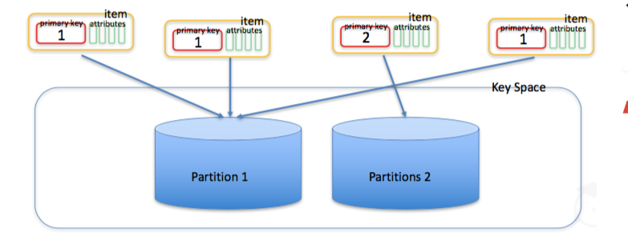
Pagination
Use LastEvaluatedKey and ExclusiveStartKey to Pagination
Can not choice from Pagination 1 to Pagination 2

Slide 10
Limit about response size
When using Query or Scan, both give respone max 1MB
How to fix: get each pack of 1MB and then handle

Slide 11
Limit about filter data
When using KeyConditions then with Sort Key we can’t use CONTAINS, IN that can only use operator EQ|LE|LT|GE|GT|BEGINS_WITH|BETWEEN
Distinguish between uppercase and lowercase letters. Example: `%Sample%` different with `%sample%`
How to fix: create function convert

Slide 12
IN OPERATOR
Only receive maximum 100 value in array IN, will have error if over 100
How to fix: use And to join condition
Emple: id IN(1,2,3…100) AND id IN(101,102,…)
Not have NOT IN(). Fix: NOT(id IN(1,2,3))

Slide 13
Cost Of Use
?
Depend to index and capacity

Slide 14
Limit About Delete Data
Can’t delete all data of the table, delete by delete table or create look delete each Item
Maximum delete 25 items for one request (?)

Slide 15
IN OPERATOR
Only receive maximum 100 value in array IN, will have error if over 100
How to fix: use And to join condition
Emple: id IN(1,2,3…100) AND id IN(101,102,…)
Not have NOT IN(). Fix: NOT(id IN(1,2,3))

Slide 16
IN OPERATOR
Only receive maximum 100 value in array IN, will have error if over 100
How to fix: use And to join condition
Emple: id IN(1,2,3…100) AND id IN(101,102,…)
Not have NOT IN(). Fix: NOT(id IN(1,2,3))

Slide 17
?
Depend to index and capacity

